Slide 1
Conley
Kindergarten
Curriculum Presentation
Please sign in and grab a packet

Slide 2
Language Arts
OBJECTIVES:
Mastery of letters and sounds
Mastery of writing letters
Mastery identifying words and sentences
Speak in complete sentences
Write in complete sentences
Identify the parts of a book
Reading books for pleasure and knowledge
Link to Language Arts Standards
http://www.cusd80.com/cms/lib6/AZ01001175/Centricity/Domain/4554/ELA_K-2nd_blueprints.pdf

Slide 3
Math
OBJECTIVES:
Mastery of counting, writing, grouping and comparing numbers to 20.
Addition and subtraction mastery to 5
  I do introduce them to problems up to 10.
Solving word problems using multiple strategies
Count to 100 by 1’s and 10’s.
Mastery of shapes, colors, days of the week, months of the year
Link to Math Standards:
http://www.cusd80.com/cms/lib6/AZ01001175/Centricity/Domain/4550/math_K_blueprints.pdf

Slide 4
Science
KINDERGARTEN STUDENTS WILL:
Conduct experiments
Make observations
Record data
Draw conclusions
Once every 5 day rotation, students will have a 35 minute block of time in STEM/Technology lab with Mrs. Kienitz. This is an additional opportunity for exploration of kindergarten science topics, experimenting, and so on.

Slide 5

Social and Emotional
Our school will be implementing the Second Step curriculum to help all elementary children develop social and emotional skills.
Goals:
Promote Social Emotional skills
Positive classroom behavior
Academic Achievement
Age-appropriate weekly lessons taught in all classrooms at all grade levels.

Slide 6
Calendar
KINDERGARTEN STUDENTS WILL:
Develop skills in math, reading, and writing
Learn the days of the week, months of the year, and today’s date
Foster responsibility and community through active student participation

Slide 7

Behavior Expectations
KINDERGARTEN STUDENTS WILL:
Behave in a way that promotes learning
Walk across our campus quietly, with hands to self, and eyes forward
Listen to teachers, students, and guests
Understand school and classroom rules and consequences
Demonstrate good character
and citizenship

Slide 8
Homework
Homework: A weekly homework packet will go home on Mondays. Homework will be due the following Friday. Please help your child to be responsible for their folder and homework.
Have your child do their work as an established routine. Please do NOT give them answers. We are trying to instill independence, so read them the instructions and then let them try to do the work by themselves.

Slide 9

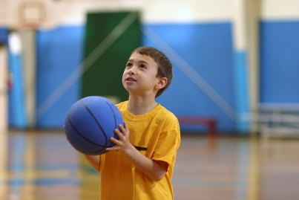
Specials
Our specials are P.E.Music, Library, and STEM/Technology Lab.
  When we have PE make sure to dress your child in gym shoes!
This year, we will have the same daily schedule! This schedule will change each quarter. I will update you when the quarter ends. To see our schedule, check the newsletter I attach to the homework each week ☺
Students are expected to behave and follow all directions while at their special classes.

Slide 10
Snack Time
Each morning our Kinders are allowed to eat snack. This is something you can provide for your student each day.
SNACKS MUST BE HEALTHY.
  No candy please!
  Veggie straws, cheeze-its are fine!
Please make sure to pack a water bottle for you student every day!

Slide 11

Lunch
Students may bring a lunch from home or receive a lunch from school.
SCHOOL LUNCHES MUST BE BOUGHT!
  Please see the QR code I have present in the classroom to put money into your child’s account!
After 20 minutes, in the cafeteria, students have a 20 minute recess outside.

Slide 12
Conferences
We have teacher/parent conferences twice a year: at the end of August and the middle of February
This August, they will be held the 23rd & the 24th
Additional conferences will be scheduled in advance with the teacher if needed.

Slide 13
Report Cards
Kindergarteners progress is identified with the following indicators: Mastery (M), Progressing (P), or Area of Concern (AC).

Slide 14
Afternoon Pickup Procedures
If picking your child up in a car, make sure to have the purple sign on the review mirror for an easier pick-up. Please stay in your car.
If you wish to personally pick them up from underneath the tents, please park in the parking lot.
Remember, kindergarten dismissal is 2:55!!

Slide 15
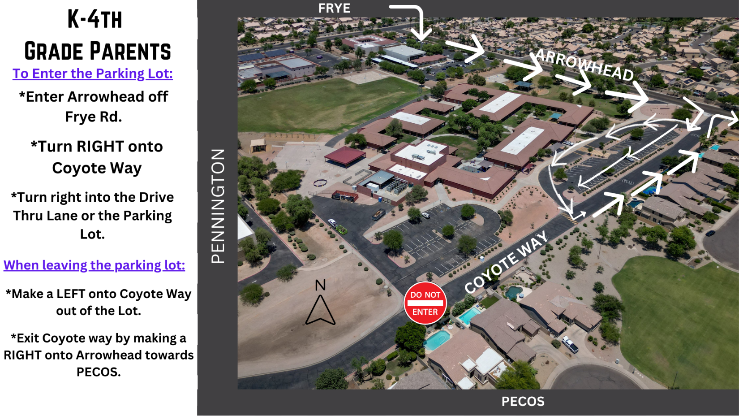
Afternoon Pickup Procedures
If picking your child up in a car, make sure to have the purple sign on the review mirror for an easier pick-up. Please stay in your car.
If you wish to personally pick them up from underneath the tents, please park in the parking lot.
Remember, kindergarten dismissal is 2:55!!

Slide 16
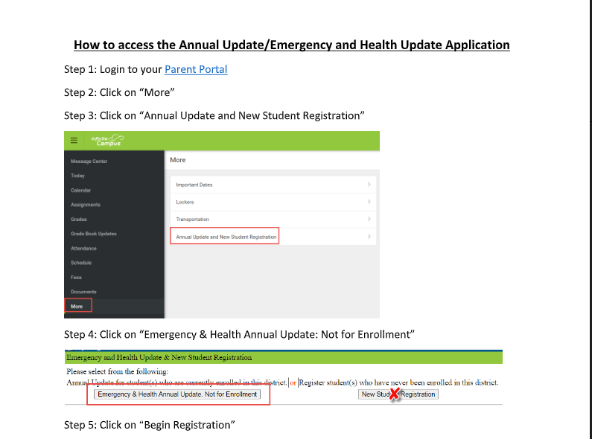
Update Parent Portal

Slide 17
Field Trips
Field trip fees are $25 for grades K-5th and 6th grade has the science camp fee for $100. You are welcome to send cash or check if you have trouble with the Parent Portal.

Slide 18
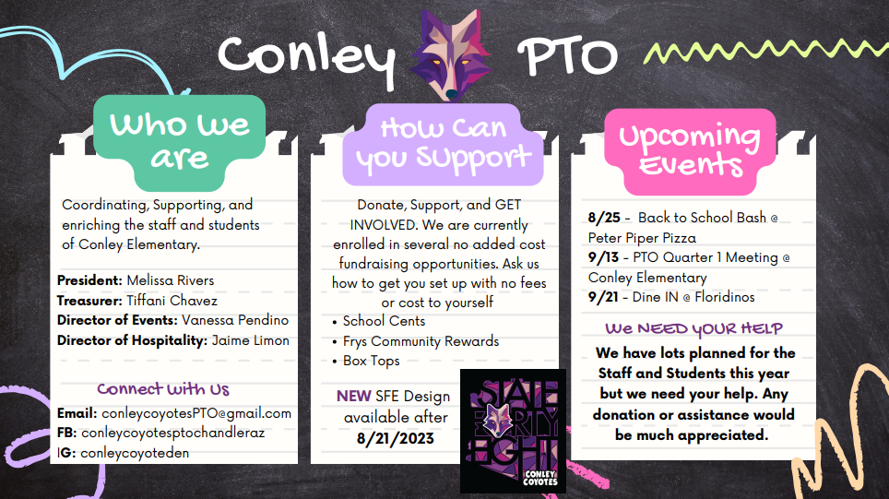
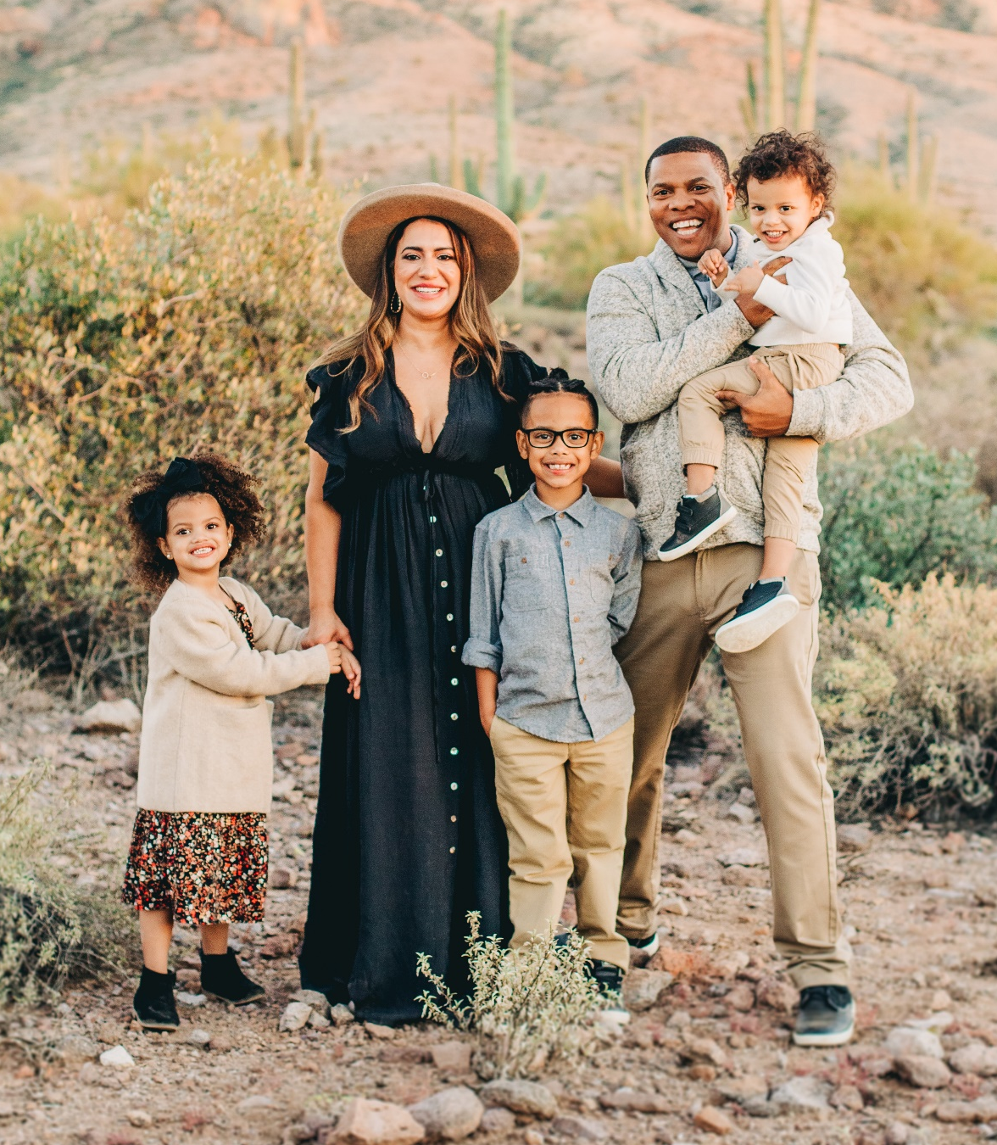
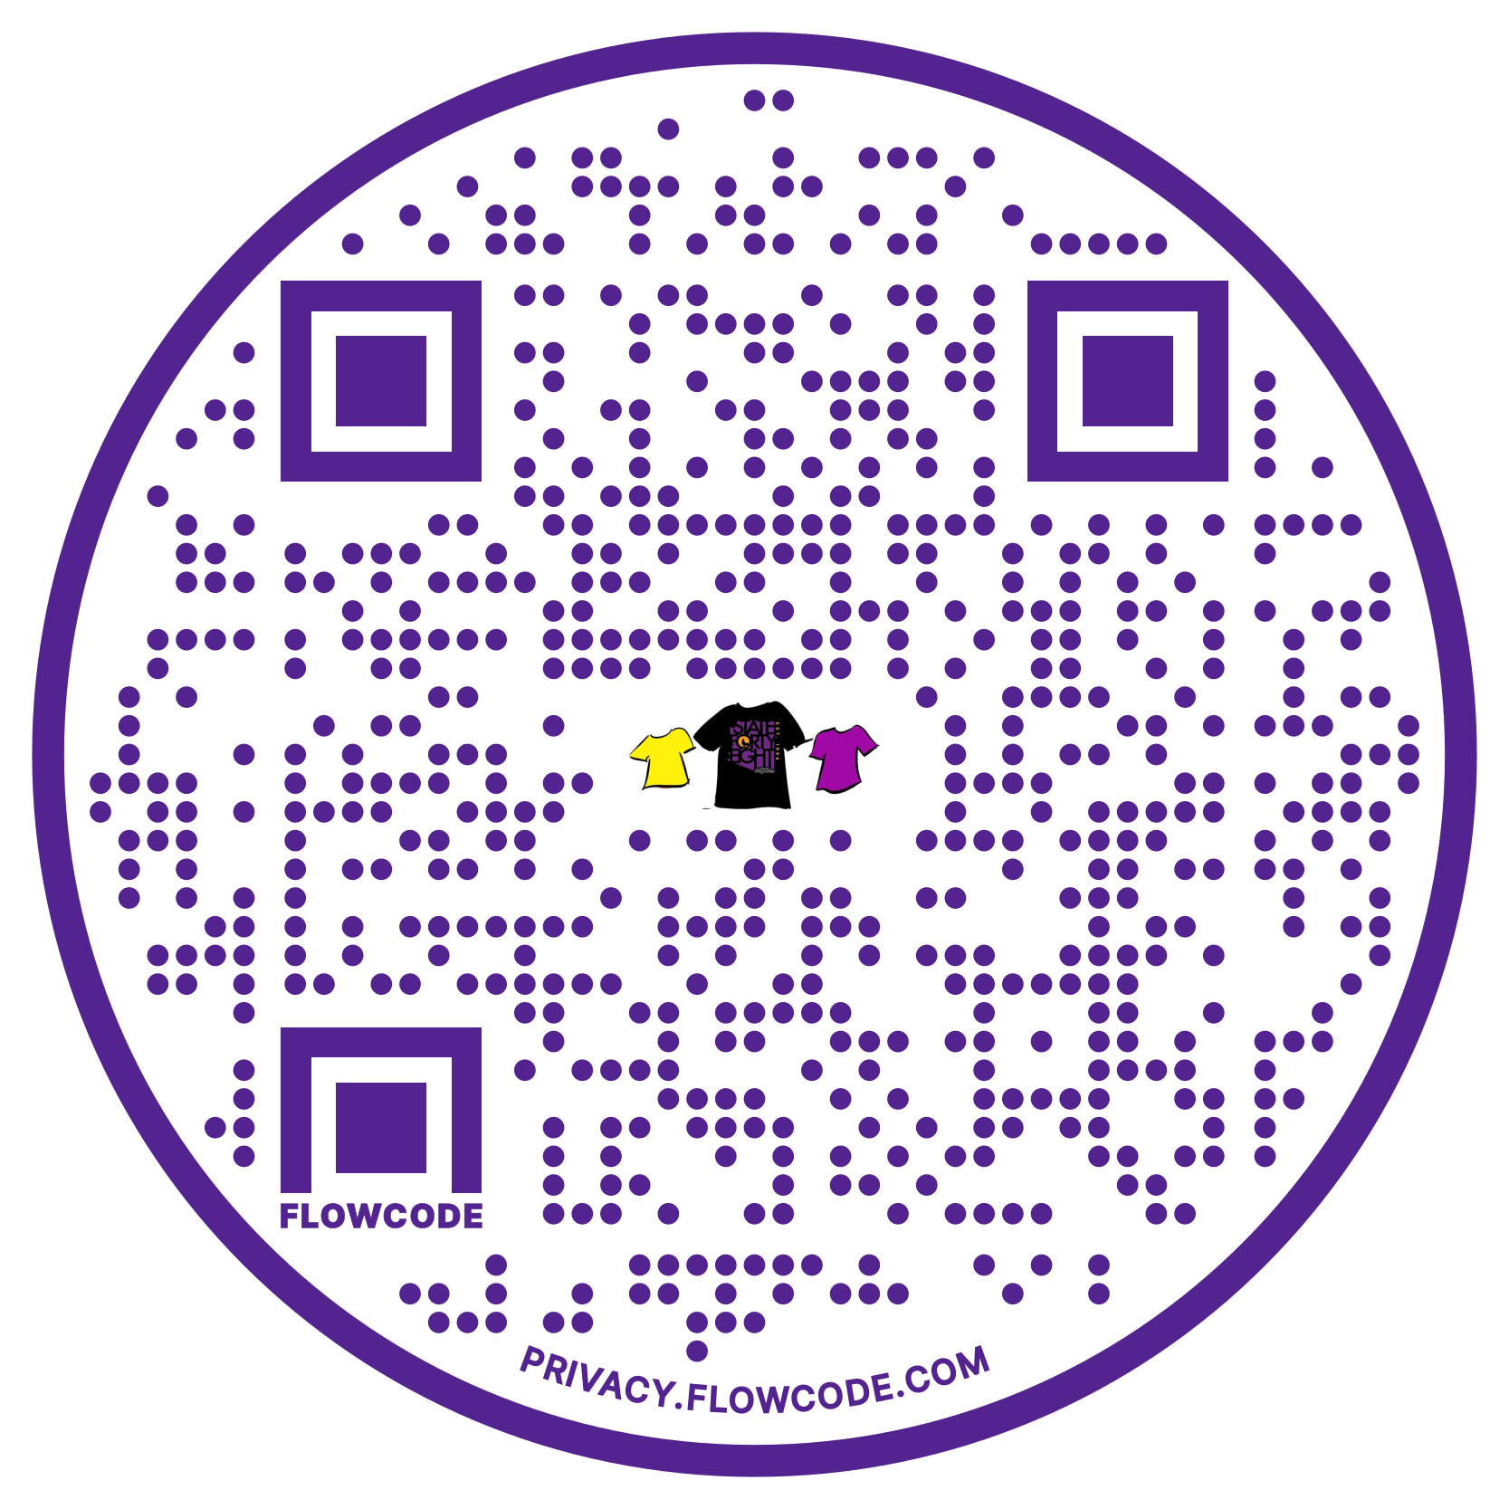
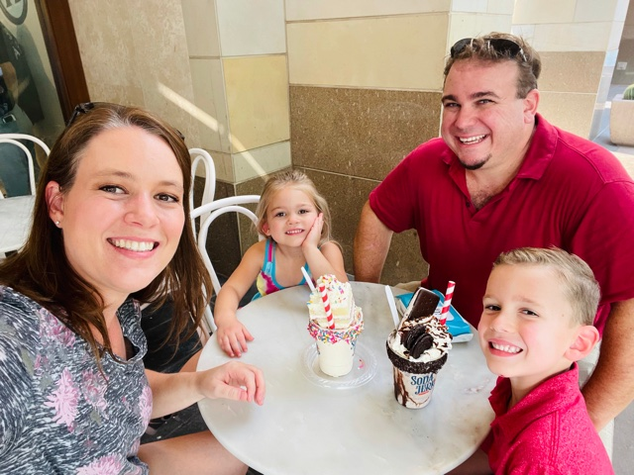


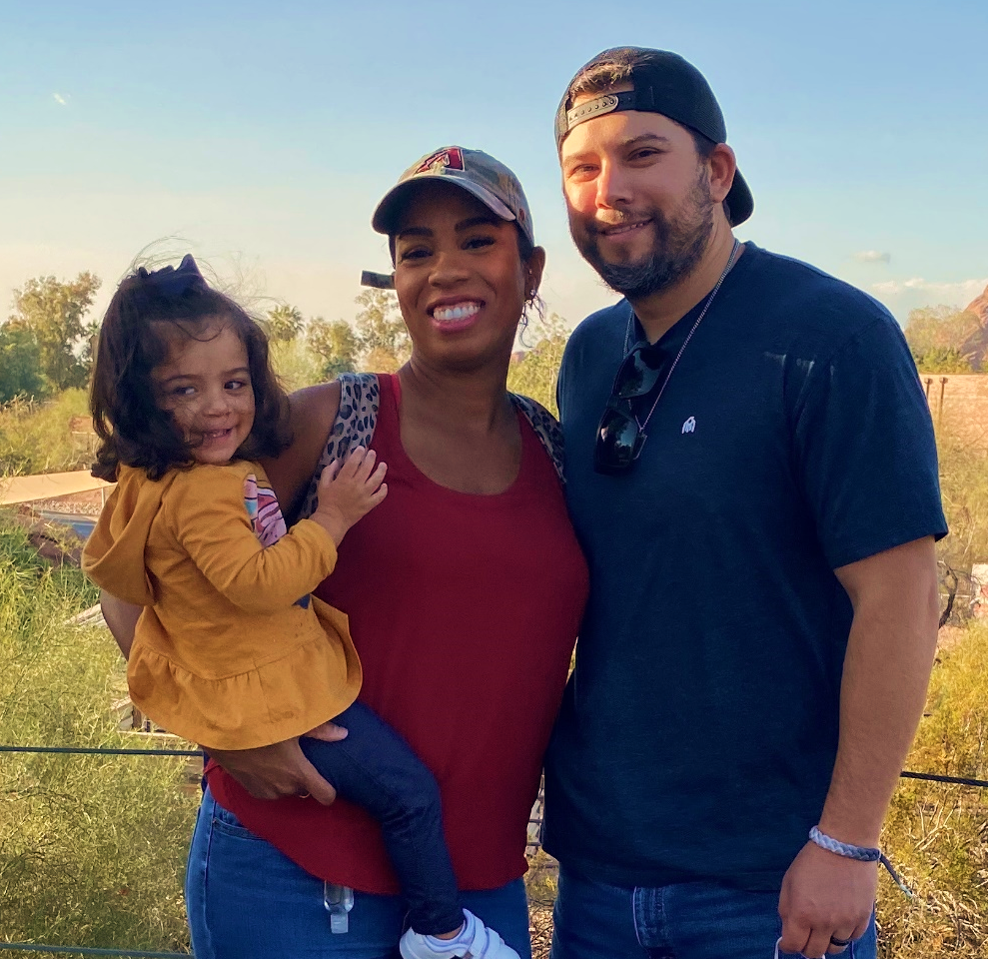






Conley PTO
Who are we?
What does PTO do?
Support teachers (appreciation luncheons, conference meals, supplies stipend, and more)
Fund school activities (scholarships, reindeer games, etc)
Fun community events
Fundraisers
Scan me to Order
Jennifer Farino, Treasurer
What’s coming up next?
Melissa Rivers, President
Restaurant Night
At Peter Piper Pizza: Thursday, August 11th (anytime between 4pm - 8pm)
Our First PTO Meeting
Date: Wednesday, August 17, 2022
Time: 5:30pm
Location: Conley Elementary Media Center
What are other ways I can help?
Tiffani Chavez, Secretary
Ongoing Fundraisers
Fry’s Community Rewards: Use organization name Conley Elementary School PTO or Organization Number VG693
Box Tops for Education: Download the app and scan your receipt or clip box tops and send to your child’s teacher
School Cents: Submit receipts from Chandler Fashion Center and The Boulevard Shops to earn money for Conley from July 1 – January 15
Connect with us!
Email: ConleyCoyotesPTO@gmail.com
Facebook: conleycoyotesptochandleraz/
Website: http://www.runpto.com/u/conley/
Instagram: conleycoyoteden/

Slide 19
Title 1 Information
https://www.loom.com/share/7b03aa2c47974e4793c242af0454cefc?sid=c665a05d-db20-480f-b8dc-7394f842566b

Slide 20

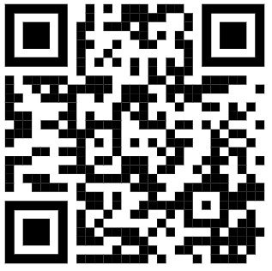

Education
TAX CREDIT
DONATE HERE
WHAT IS TAX CREDIT?

Slide 21

Thank you for attending.
I am happy to address any further questions about general kindergarten topics.
If you have a specific question regarding your child, please fill out a question form you can find by the door!

